Slide 1
Responding to Emerging Outbreaks: Sharing the Load among Laboratory System Partners
Christine Bean, Rodney Rohde
Building Bridges Across the Laboratory Community – Feb 28, 2024

Slide 2
Funding Statement
This resource was made possible by cooperative agreement NU47OE000107 from Centers for Disease Control and Prevention (CDC). Its contents are solely the responsibility of the American Society for Clinical Pathology (ASCP) and do not necessarily represent the official views of CDC.

Slide 3
Format of Today’s Session
Introduction of Subject Matter Experts & Case Study
  Case Study 1: NH Response to Hepatitis C Outbreak
  Case Study 2: Rabies: A New Look at an Old Foe!
Q & A Session
Session Wrap-Up
  Next month’s webinar
  CMLE Credit Claiming
  Resources

Slide 4
NH Response to Hepatitis C Outbreak
Christine Bean, PhD, MBA, MLS (ASCP)
APHL Chief Learning Officer and former
NH Public Health Laboratory Director

Slide 5
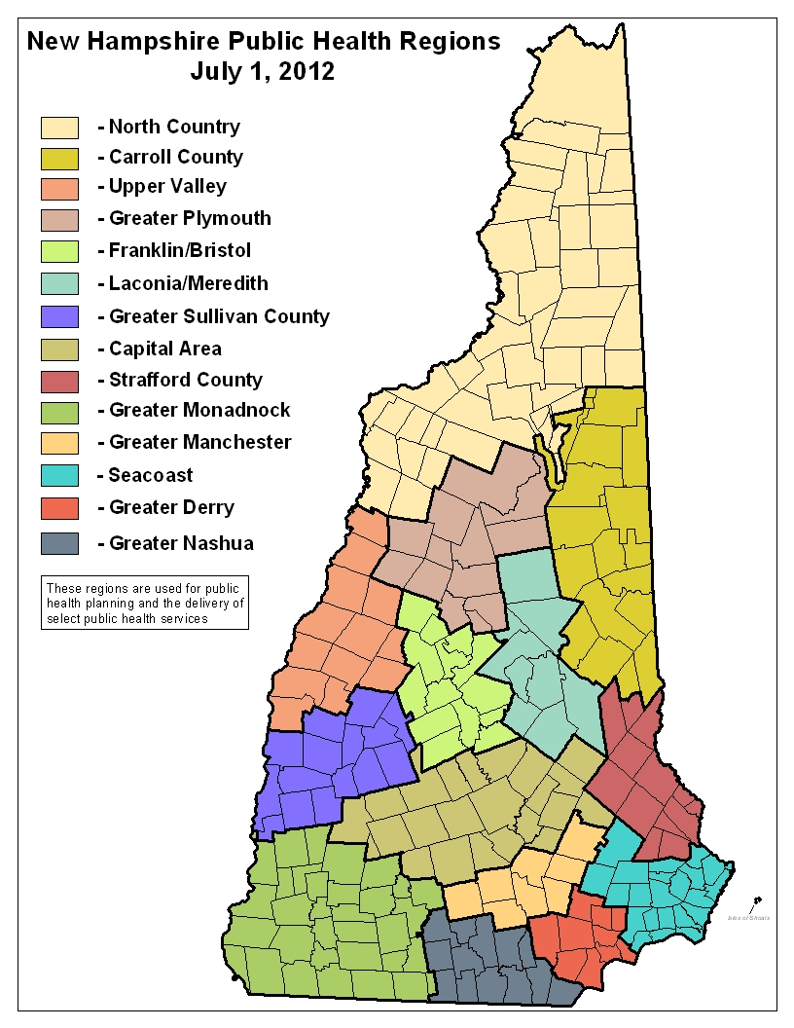


NH Public Health System
NH Department of Health and Human Services (lab, epi, surveillance, etc.)
14 Public Health Regions
234 municipalities (Health Officers)
2 municipal Health Departments
26 Hospitals/13 Critical Access
Notes:
GARRETT: The majority of public health services in NH are delivered by the state health department. Unlike most states, county services in NH are fairly limited and do not include public health services. NH DHHS has supported and implemented a process of regionalization for public health services that has largely focused on public health preparedness and response coordination. 14 Public Health Regions have been established to facilitate multi-jurisdiction, multi-discipline planning across the 11 CDC community sectors. Each municipality in NH has an appointed Health Officer with varying degrees of responsibilities, local services provided, and background in public health. The cities of Manchester and Nashua have local health departments that provide broad public health services. There are 26 hospitals across the state, 13 of which are critical access facilities. NH has a population of 1.3 million with populations centers toward the south.

Slide 6
Situation Awareness
MAY 2012
Cluster of 4 HCV Infections
Epi Investigation Reveals Common Source: Cardiac Procedure Room & Recovery Area
Testing Indicated for 1,214 Patients (treated between Oct. 1, 2010 – May 25, 2012)
Testing Conducted by Hospital & NH DHHS in Phase I
Linked to Healthcare Worker (Drug Diversion)
Outbreak
Notes:
CHRIS:

Slide 7












DRUG DIVERSION* SPREADS INFECTION FROM HEALTHCARE PROVIDERS TO PATIENTS
CONTAMINATED INJECTION EQUIPMENT AND SUPPLIES
present in the patient care environment
HEALTHCARE PROVIDER
with Hepatitis C or other bloodborne infection tampers with injectable drug
EXPOSURE OF PATIENT
results from use of contaminated drug or equipment for patient injection or infusion
306089-D
*Drug diversion occurs when prescription medicines are obtained or used illegally by healthcare providers.
FOR MORE INFORMATION, VISIT CDC.GOV/INJECTIONSAFETY/DRUGDIVERSION/INDEX.HTML.

Slide 8
Healthcare worker history
Cardiac Catheterization Unit traveler technician
History of work at 13 hospitals in 8 states
Drug diversion was the cause of the outbreak
32 cases in NH and 46 in U.S. were linked to HCW
HCW arrested 7/19/12 and put into custody

Slide 9
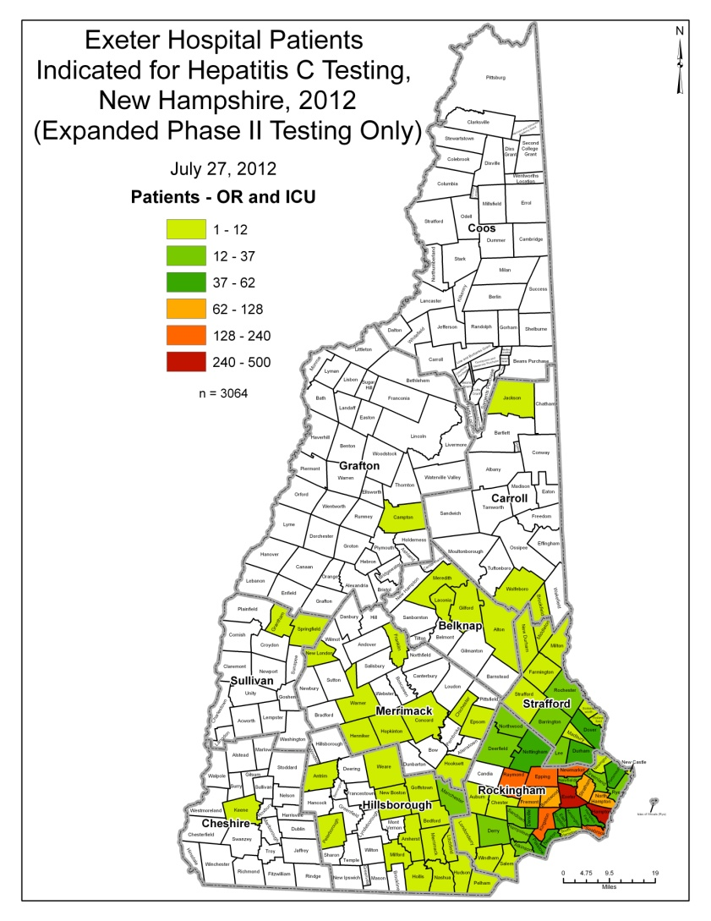
Situation development
JULY 2012
Epi Investigation Expanded
  Operating Room
  Intensive Care Unit
Testing Indicated for 3,505 Patients in Phase II (seen Apr. 1, 2011 – May 25, 2012)
Notes:
CHRIS:

Slide 10
Situation development1
JULY 2012
Rapid Testing to be Offered
Regions Establish 8 Testing Clinics at 4 Locations
  Stratham
  Plaistow
  Rochester
  Manchester
Aug. 16
Aug. 16-18
Aug. 10 & 11
Aug. 14 & 15
Notes:
CHRIS: The Stratham Clinic offered testing services over two days (with each day offering appointments over an 8-hour operational period). Staff were scheduled for 4 to 8-hour shifts.

Slide 11
Goals of Laboratory Response
Identify HCV infected individuals from the potentially exposed patients.
Determine HCV genetic relatedness to identify HCV infected individuals who are associated with the outbreak.
Perform testing following quality assurance guidelines and best laboratory practice.

Slide 12
Situation development
Requesting State Assistance
  Staffing & Resources (Clinical Branch)
    Phlebotomy
    Laboratory
    Behavioral Health Counselors
Public Health Emergency Declaration
  Issued by Governor/DHHS Commissioner
  Volunteer Liability Protections
  Agents of State
Notes:
GARRETT: While the response to the Hepatitis C event did not require local officials to request SNS assistance, the MACE was used to request assistance from the state health department to oversee the Clinical Branch staffing and functions. While each region has recruited medical volunteers, recruitment efforts had largely focused on medical countermeasure dispensing (vaccines and medications) and not on recruiting healthcare professionals skilled in phlebotomy. Additionally, the clinical materiel required to support testing services was not available through cached supplies in the region. In addition to requests for assistance to the state, each public health region was asked to deploy several resources (screens, refrigerators, and volunteers) to the region. The state health department coordinated deployment of these resources into the regions where testing services were provided.

Slide 13
Laboratory Response Network Utilization
PHL notified LRN via Health Alert Network messaging to recruit volunteers for assistance with clinics
Phlebotomists and testers were recruited
24 testing personnel were trained and competency assessed prior to event
Many volunteers were used in multiple clinics once trained

Slide 14
Activate pod
STAFF ACTIVATION
Greeting/Registration
CERT/MRC/ESAR-VHP/Red Cross
Clinic Flow
CERT/MRC/ESAR-VHP
Phlebotomy
Metropolitan Medical Response System
AmeriCorps/VISTA
NH Laboratory Response Network
NH Hospital Association
AmeriCorps/VISTA
Hanscom AFB
Hanscom AFB
Laboratory
NH Public Health Laboratory
Post-Draw Monitoring
MRC & EMS
Results & Health Education
NH DHHS
Behavioral Health
NH Disaster Behavioral Health Response Team
NH Laboratory Response Network
Manchester & Nashua Health Departments
Notes:
MARY: This slide shows the various volunteer groups that assisted during the two-day clinic in Stratham: CERT Teams (Community Emergency Response Teams), 10 Medical Reserve Corps units from NH, Citizen Corps, American Red Cross, AmeriCorps/ Vista, and an Air Force Medical Team from Hansom AFB in Mass. These groups assisted w/greeting, registration, and clinic flow.
Groups that assisted with phlebotomy were the Metropolitan Medical Response Team, the NH laboratory Response Network, and the NH Hospital Assoc.
The NH Disaster Behavioral Health Team were providing assistance in talking w/patients, keeping them calm, and assisting patient educators with providing positive results to patients.
We organized the two-day clinic in Stratham in two shifts resulting in over 50 volunteers per shift, per day. Approximately, 350 volunteers were utilized statewide in all of the 4 clinic sites.

Slide 15
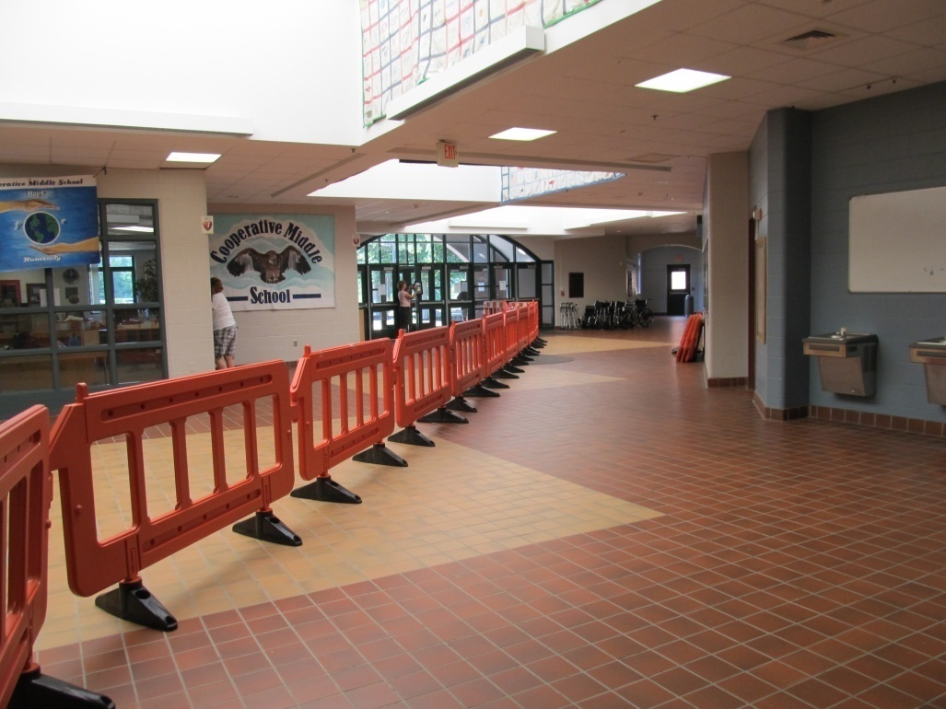
Activate pod2
FACILITY SET-UP
CLINIC FLOW GROUP
Maintain Flow
Maintain Accessibility
Assist Patients with Functional Needs
Identify Bottle Necks
Transfer Resources (Runners)
Notes:
MARY: Clinic flow staff were positioned throughout the POD to maintain patient flow and to identify and report bottle necks. Clinic flow staff were positioned in both non-clinical and clinical areas.
Clinic flow staff or runners assisted some patients through the process if they were using wheelchairs. We were fortunate that we had many volunteers who could stay with a wheelchair-bound patient who did not have a family member with them, and assist them throughout the clinic process.

Slide 16
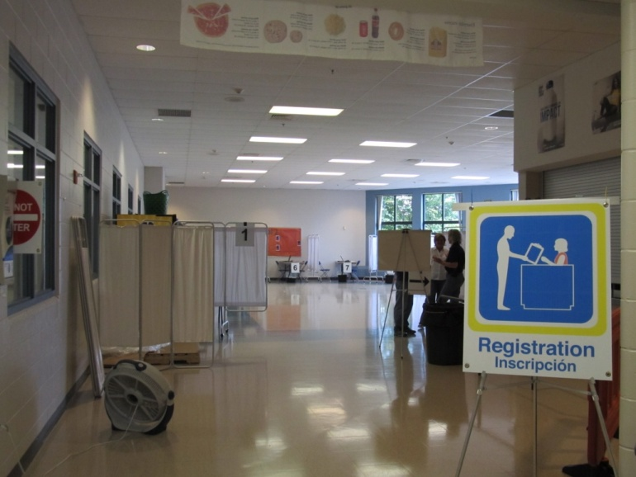
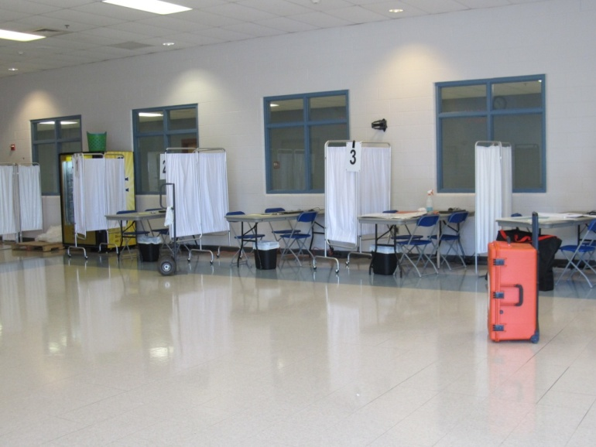
Activate pod3
FACILITY SET-UP
REGISTRATION GROUP
Scan Identification
Provide Registration Packet & POD Number
Explain Clinic Process
Provide Additional Health Education (if needed)
Notes:
MARY: Patients were asked to show photo identification and then proceed to one of 10 registration tables.
The patient was asked their demographics, date of medical procedure, and if they received a letter for their appointed time. The electronic registration system worked well. Patients were explained the clinic process and provided with additional health education if needed. If someone did not have an appointment or was not a pre-identified patient (worried well), we still provided service, and turned no one away.
Now, Chris will discuss the clinical branch of the operation from pre to post draw.

Slide 17
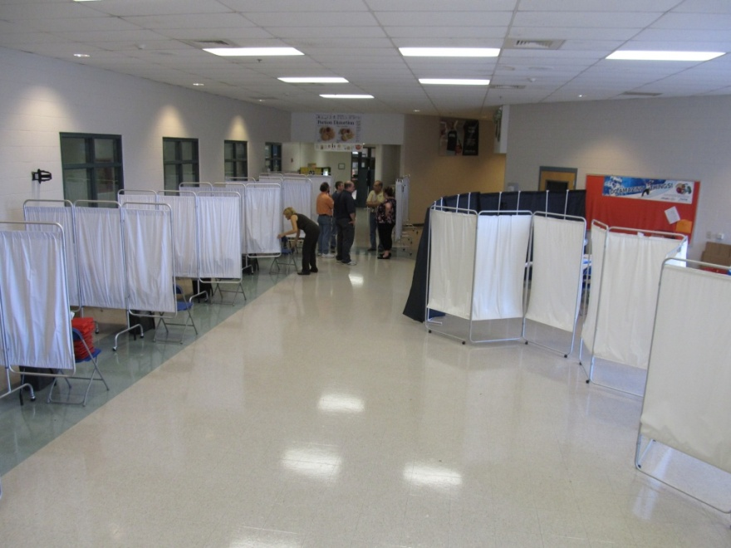
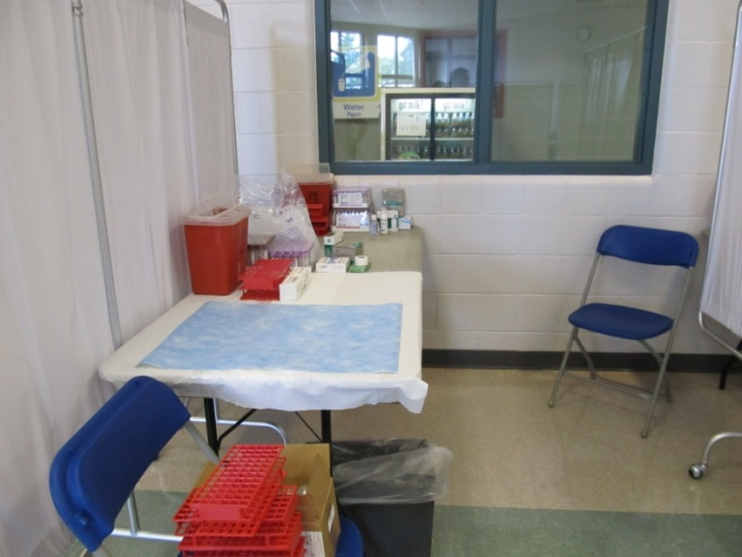
Activate pod4
FACILITY SET-UP
PHLEBOTOMY GROUP
Review Patient Forms
Collect Specimens
  1 Lavender EDTA Tube
  2 Serum Separator Tubes
Label Specimens
Store Specimens (for Transfer to Lab)
1190 Patients Phlebotomized
Notes:
JILL: Upon registration each patient was assigned a POD#. This number was used along with name and date of birth to label paperwork and blood samples. The patient was then escorted to the Phlebotomy area. Each phlebotomist was instructed to assure the patient name and date of birth matched with the paperwork. Venipunctures were performed where 2 SST tubes and one lavender tube were obtained. The lavender tube was used for the rapid testing. The SST tubes were used to collect serum to be tested following the laboratory HCV algorithm. Almost 1200 people were drawn at these sites.

Slide 18
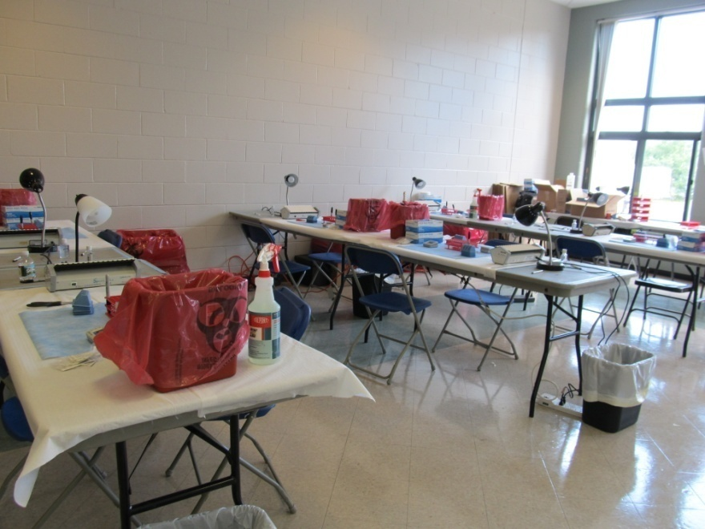
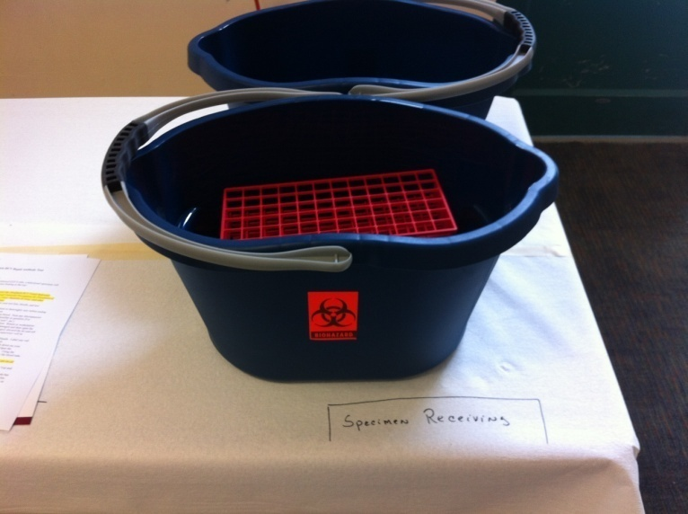
Activate pod5
FACILITY SET-UP
LABORATORY GROUP
Transfer (from Phlebotomy)
Intake Specimen
Test Specimen
Record & Transfer Results
Transport (to State Lab)
Notes:
JILL: The Laboratory Group was positioned proximate to the Phlebotomy Group to facilitate ease of transfer of specimens from the phlebotomy stations to the specimen intake station. Screens were erected around the laboratory area to minimize patient anxiety from seeing laboratory technicians in their Personal Protective Equipment (PPE). A laboratory technician was assigned as a “Runner” to safely transfer specimens to the laboratory area. During the intake process Laboratory Staff assured that specimens and requisitions were correctly labeled. They arranged specimens for testing staff in batches of ten. The actual test had a 20 minute incubation period. Worksheets were generated per batch to record test results, as well as on the laboratory requisition and the two patient forms. All positive and invalid tests were repeated by another tester. Another “Runner” delivered all test results to the Results Group to call the patient by their POD number and provide confidential post-test counseling. We had arranged an emergency Courier service to transport specimens and requisitions back to the state laboratory in Concord for follow-up testing.

Slide 19
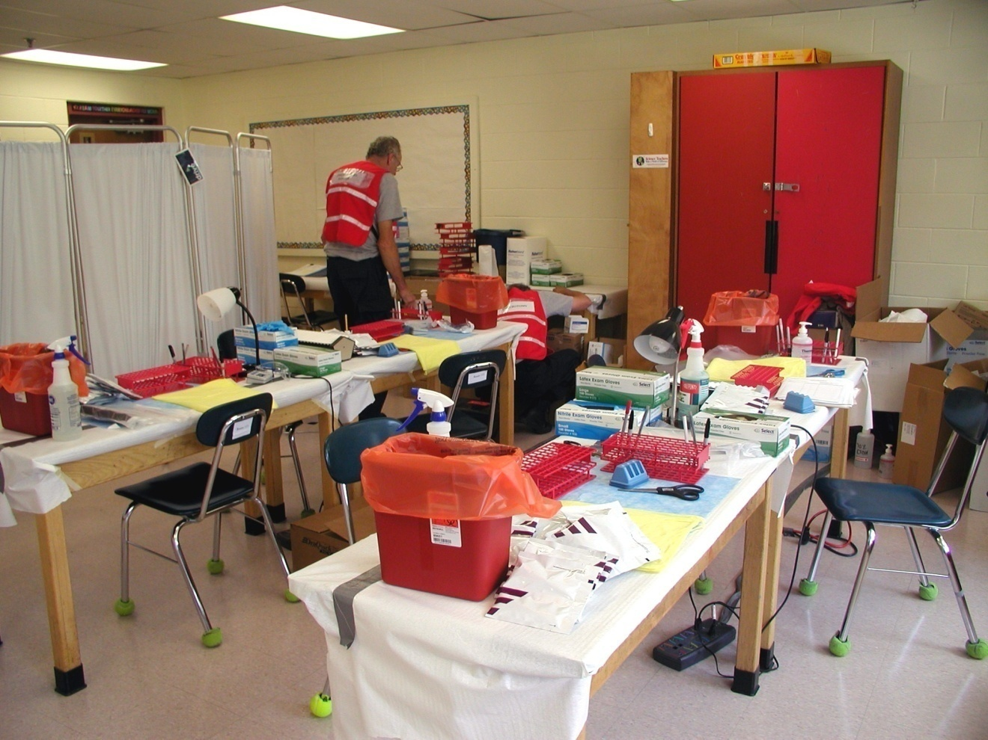
HCV POD Testing area

Slide 20
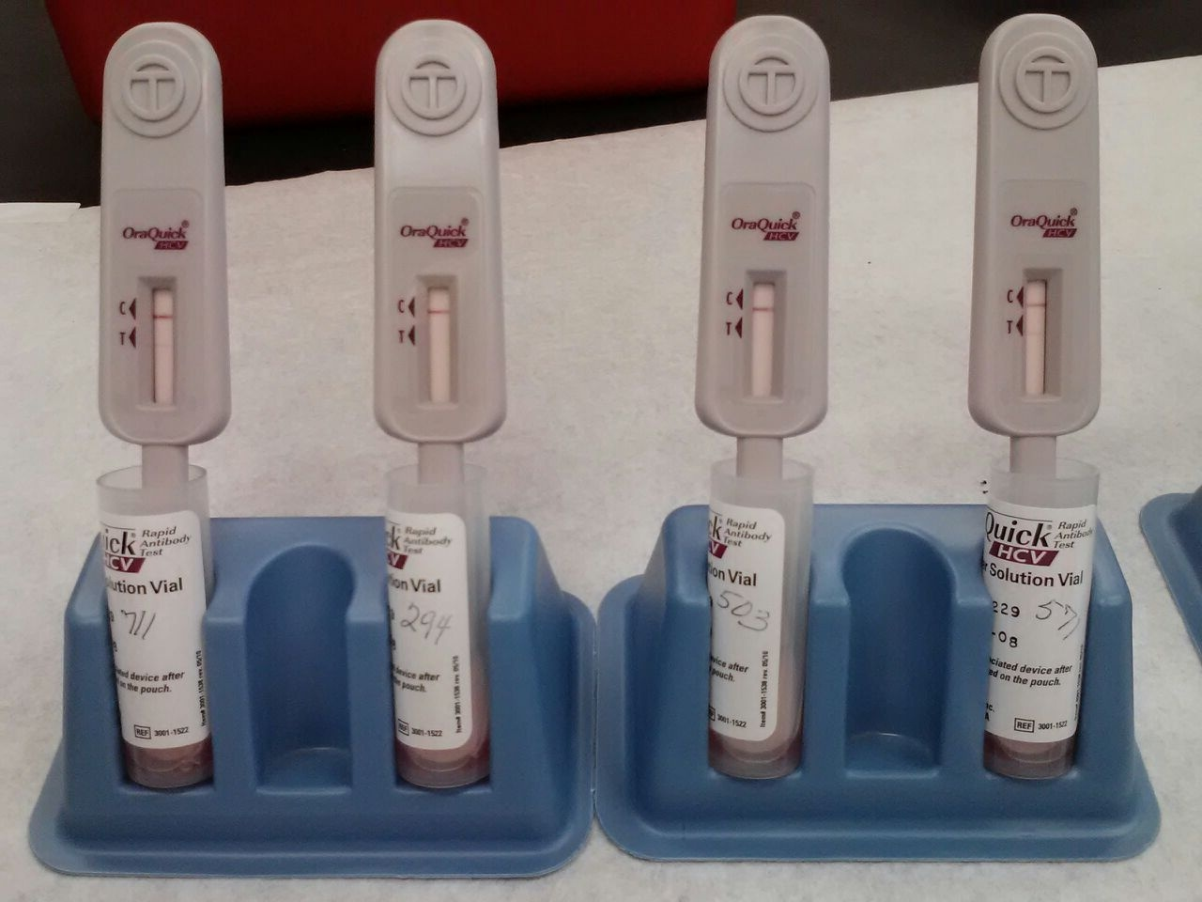
HCV Rapid Test Results

Slide 21
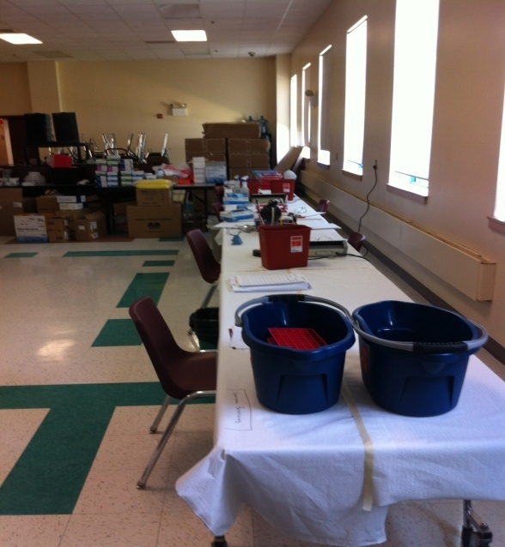

Activate pod6
LABORATORY GROUP
8 PODs/7 Days
24 Credentialed Testers (trained prior to testing)
1215 Rapid Tests (including QC)
  22 tested positive
Laboratory Manager Oversight (each shift)
All Positive & Invalid Tests Repeated (by another tester)
All Results Reviewed by Laboratory Manager
Notes:
JILL: When the NH PHL was activated, a core group met and developed plans internally. In order to perform testing in an off-site facility, the first we realized was that we needed to obtain an additional certificate of compliance from the US federal agency, the Centers for Medicare and Medicaid Services (CMS). The CMS regulates all laboratory testing (except research) performed on humans in the U.S. through the Clinical Laboratory Improvement Amendments (CLIA). From positive stakeholder relations, we obtained the certificate from the regional office in Boston within 48 hours. To recruit testers and phlebotomists, we contacted the Laboratory Response Network (LRN) in our state. Many hospital medical technologists agreed to volunteer their skills and time. MMRS also supplied phlebotomists. The rapid test is a waived test and by CLIA regulations, can be performed by anyone who has the ability to read and demonstrate performance and interpret results correctly. Because this was becoming a legal event, we chose to use testers that had extensive laboratory experience, and were all trained to perform with a high level of competency. OraSure representatives made themselves available at the Stratham sites as a technical resource. These PODs were the first time this test was used in a large clinic, so they were excited to see how this test was utilized in such a setting. At each site, a NH PHL lab manager was assigned to oversee all testing activities. All positive and questionable tests were repeated by a different tester. All results and transcriptions were reviewed by the lab manager before they were released. We took temperatures twice/day and ran QC at each shift.

Slide 22
Lessons Learned
NH PHL lead role setting up the POD for testing
Communication with the public
Collaboration and Partnership
  Laboratory capacity required partners which included internal laboratory staff from all departments, hospital partners, CDC, other state public health laboratories and APHL

Slide 23
Outcomes from event
Law changes requiring reporting of misconduct
Law changes requiring HCV to be a reportable disease in NH
Strengthened partnerships with state and regional partners
Development of the Public Health Laboratory Systems Database for inventory of tests performed by state PHL’s
*The HCW was sentenced to 39 years in prison in December 2013 for causing the multi-state outbreak

Slide 24

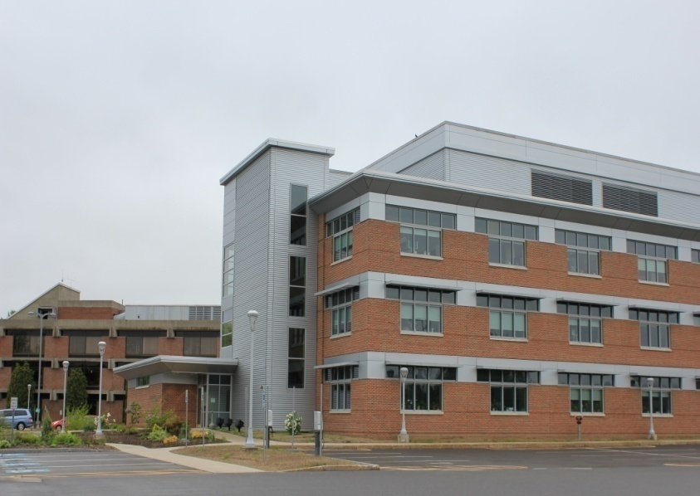
Acknowledgement
NH PHL Staff Members of
  Molecular Diagnostics Laboratory
  Virology Laboratory
  Central Receiving Laboratory
  IT Team
NH Bureau Infectious Disease
NH LRN Laboratories
NH Emergency Management
CDC Division of Viral Hepatitis Laboratory
New Hampshire Public Health Laboratories

Slide 25

Rabies: A New Look at an Old Foe!
Rodney E. Rohde, PhD, MS, SM(ASCP)^{CM} SV^{CM}, MB^{CM} FACSc
University Distinguished & Regents’ Professor, Chair
College of Health Professions, Medical Laboratory Science Program

Slide 26
Acknowledgment
Acknowledgment to Kathy Parker, Kathy.parker@dshs.Texas.gov
512-776-2886

Slide 27
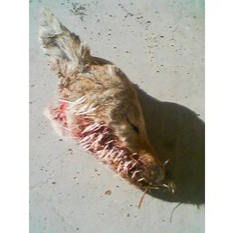
History of Rabies Epizootics in Texas 1970-1987
Rabies movement across Texas
El Paso County >80 dogs
Webb County
    1975 = zero cases
    1976-77 = 56 rabid dogs
Outbreak Response
    Low-cost rabies clinics
    Animal control officer deficiencies
    Depopulation
    Teaching proactive or awareness techniques to communities
**1979: Chapter 826: Rabies Control Act … requiring vaccination.

Slide 28

Rabies History 1987-1988
CDC confirms that the Urban Mexican Dog Variant was in Starr County. Once established in Texas, the variant was renamed the Domestic Dog/Coyote variant.
Texas is the only state with a canine variant.
Gray Fox variant epizootic started in West/Central Texas resulting in a lot of spillover into other mammals.
V-RG (vaccinia–rabies glycoprotein; a recombinant vaccine derived from a vaccinia virus that carries the rabies glycoprotein)
  development
  field studies
  eventual approval

Slide 29
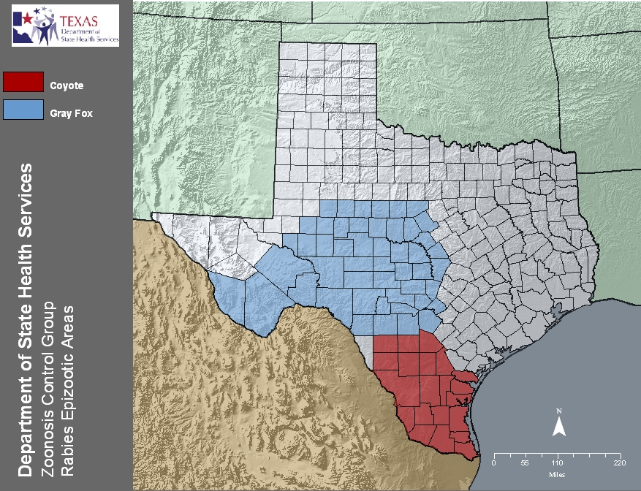
Two Epizootics

Slide 30
Rabies History 1989-1994
1993-94: Governor Ann Richards declared a state health emergency to combat the two growing epizootics occurring in Texas.
Two human deaths – 1991 and 1994
Translocation of rabid coyotes (AL & FL) and fox (MT & Netherlands) to other states and countries.
Thus, the creation of a statewide quarantine regarding the transport of coyotes, fox, skunk, and raccoons.
ORVP funding!

Slide 31
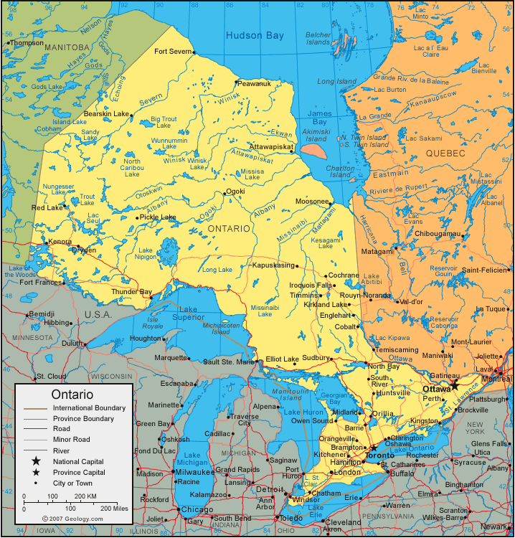
Creation of the Texas Oral Rabies Vaccination Program
Who is currently conducting an ORVP?
Europe and Canada
Ontario Ministry of Natural resources

Slide 32
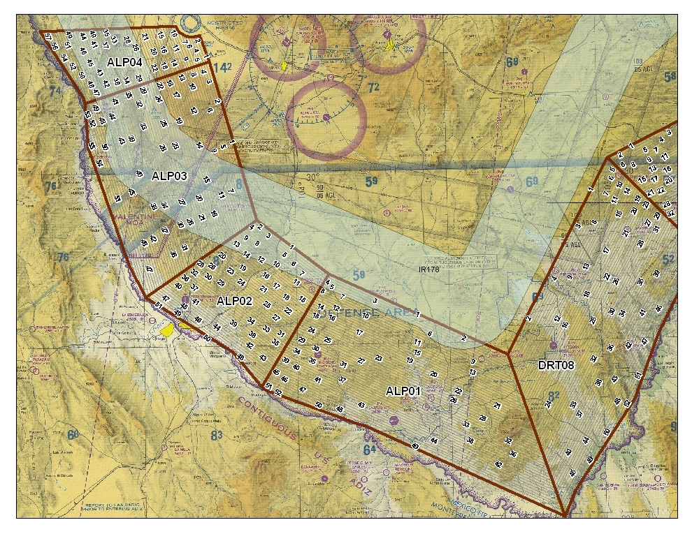
Texas Oral Rabies Vaccination Program
DSHS (formerly, TDH)
Texas Wildlife Services (USDA and Agri-Life)
Texas Military Forces
USDA (APHIS) National Rabies Management Program
Multiple other local, regional, state, federal and international agencies/individuals/ businesses

Slide 33
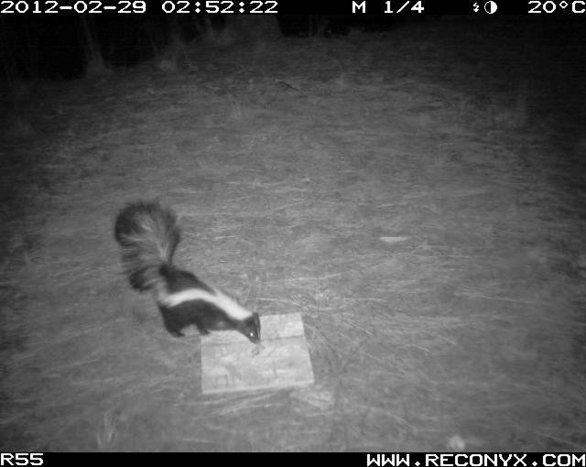
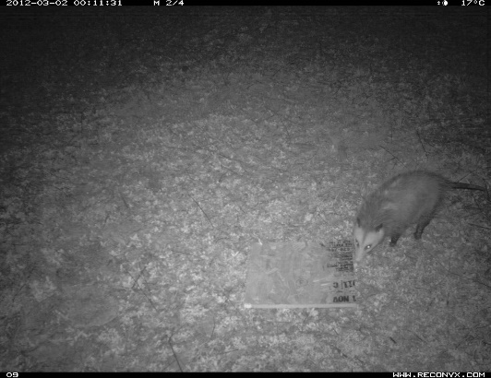
Development of the Texas ORVP
Baiting study conducted at Texas A&M University; what foods do coyotes prefer?
Conducted vaccine-efficacy trials to see if the coyotes were eating the bait and seroconverting. Tested multiple other animals.
Conducted safety studies.
The following year the same studies were repeated for gray fox.

Slide 34
ORVP Basics
When and Why ---
Where ---
January is the best time
  Vaccine is preserved
  Wildlife are searching for food sources
  Flying is more comfortable in cooler temperatures
South Texas – create a buffer zone around positive cases then push back to the border maintenance zone
West Texas – create a buffer zone around positive areas and adjusted zone to adapt to identifications and movements

Slide 35
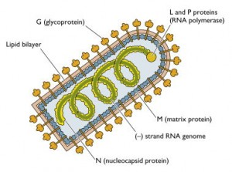
V-RG – Vaccinia-Rabies Glycoprotein
Rabies virus structure
V-RG is a recombinant vaccine made from a live, weakened vaccinia (V) virus that carries the rabies antigen in the form of rabies glycoprotein (RG).
RG is the protective sheath that surrounds the rabies virus and elicits an immune response when swallowed by raccoons, gray foxes, coyotes, and other animals.
www.virology.ws/.../02/vsv_virion-300x223.jpg
The vaccine cannot cause rabies. Why?
  It contains only the non-infective surface proteins of the virus.
  The virus needs its nuclear material to replicate and cause infection.

Slide 36
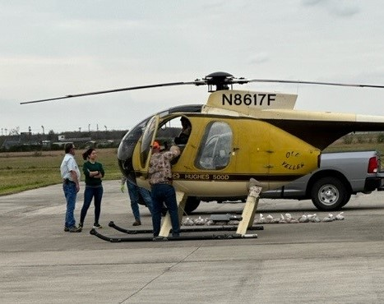
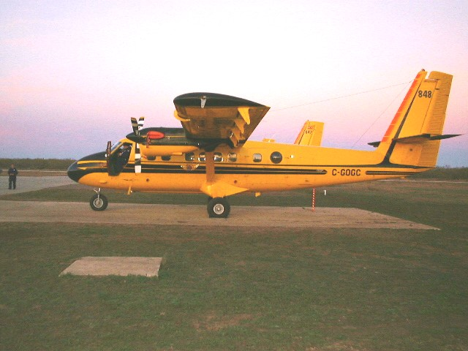
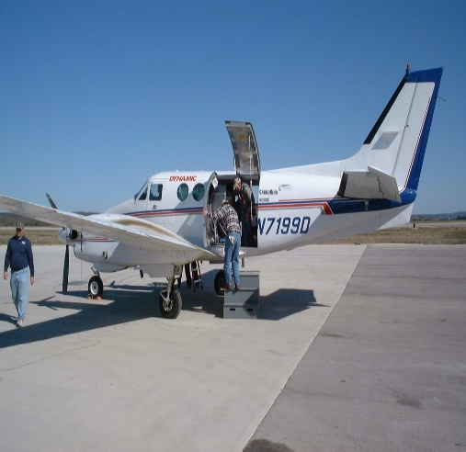
Types of Aircraft

Slide 37

Aerial Delivery of Vaccine - original
Vaccine

Slide 38
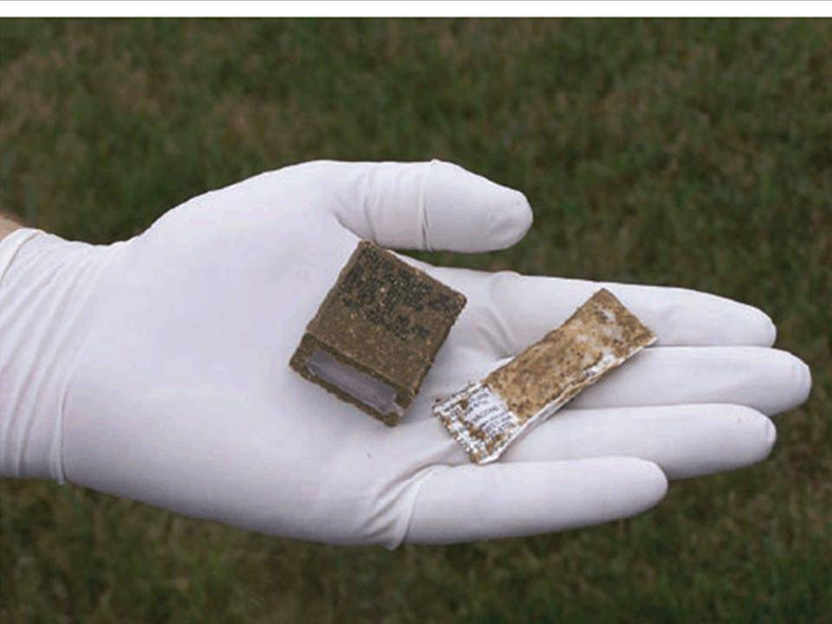
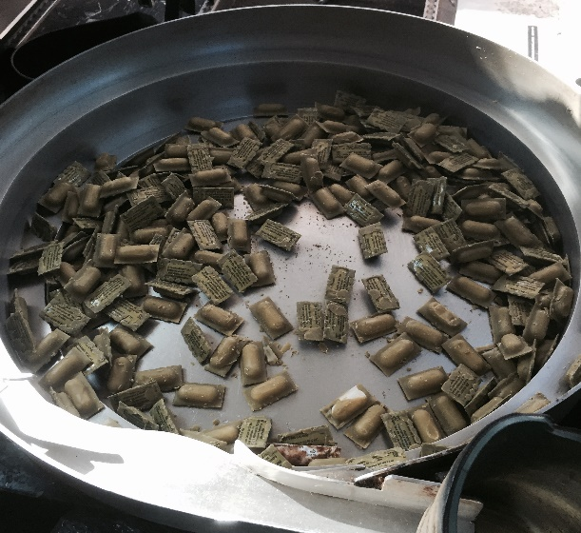
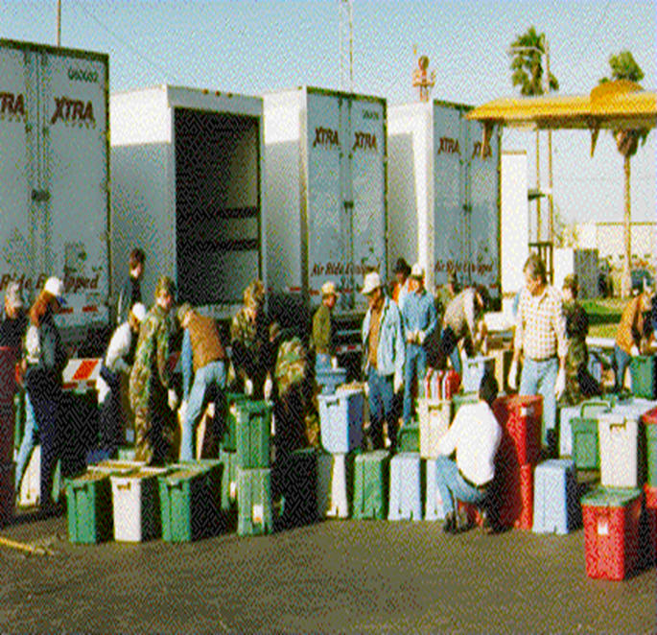
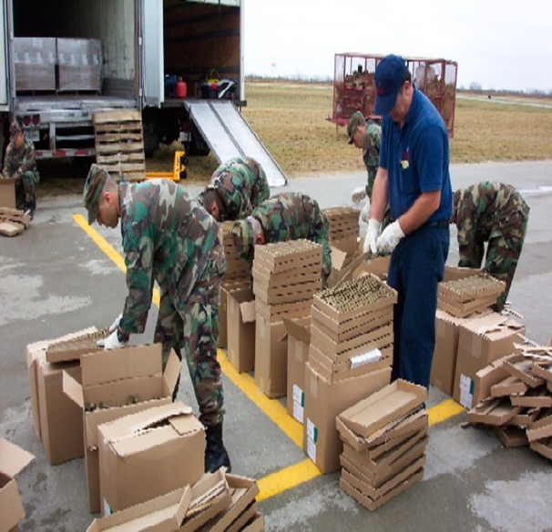
Vaccines/Bait

Slide 39
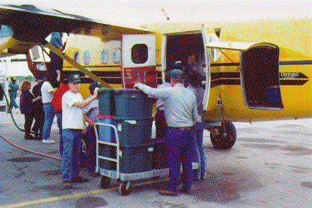
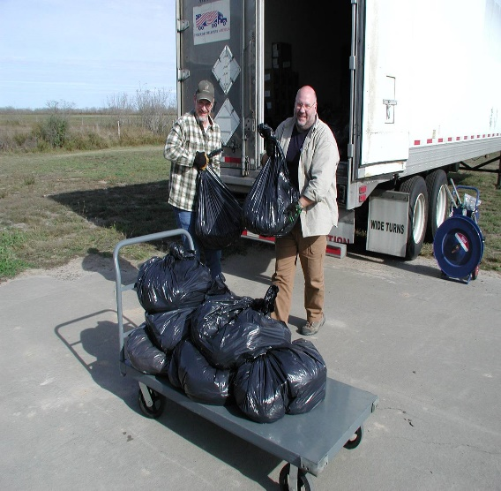
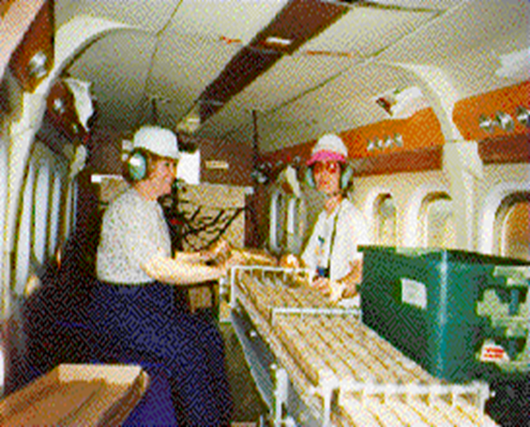
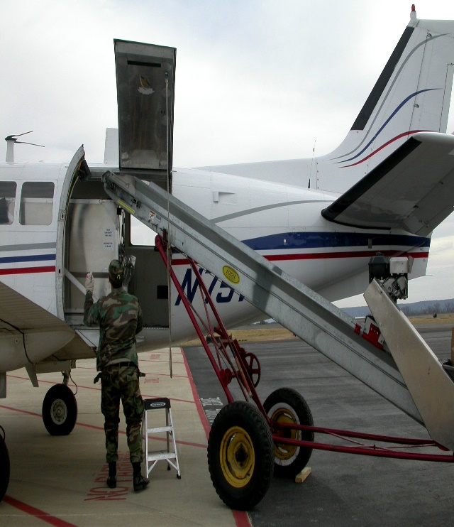
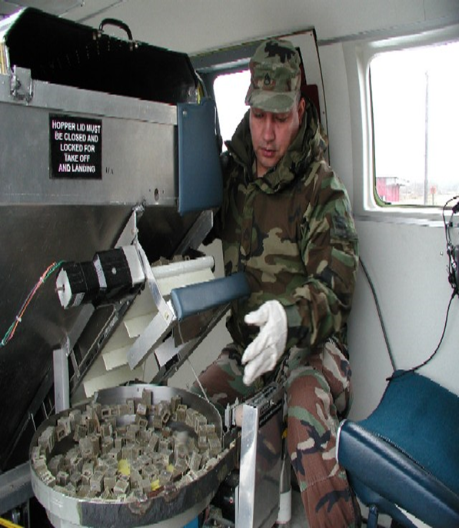
Bait
Technology

Slide 40
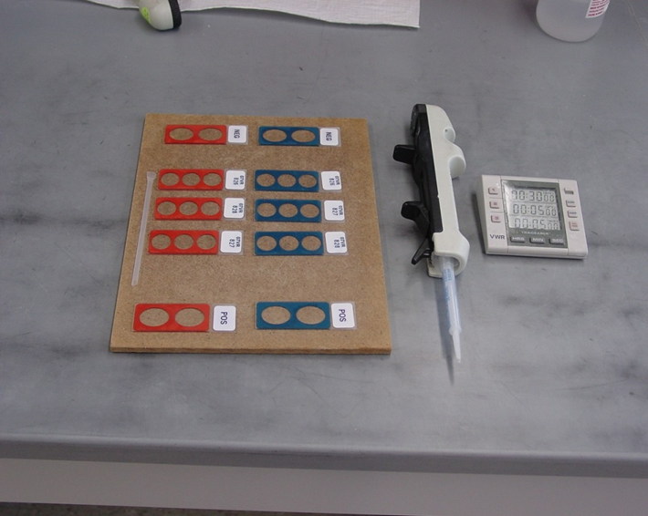
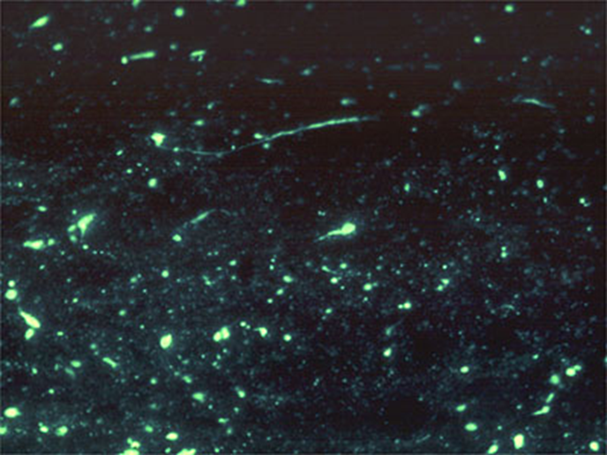
The Laboratory Impact
Testing
Molecular Typing
  Creation of a unique position
National and global assistance
  Establishment of the Texas DSHS Regional Rabies Reference Laboratory

Slide 41
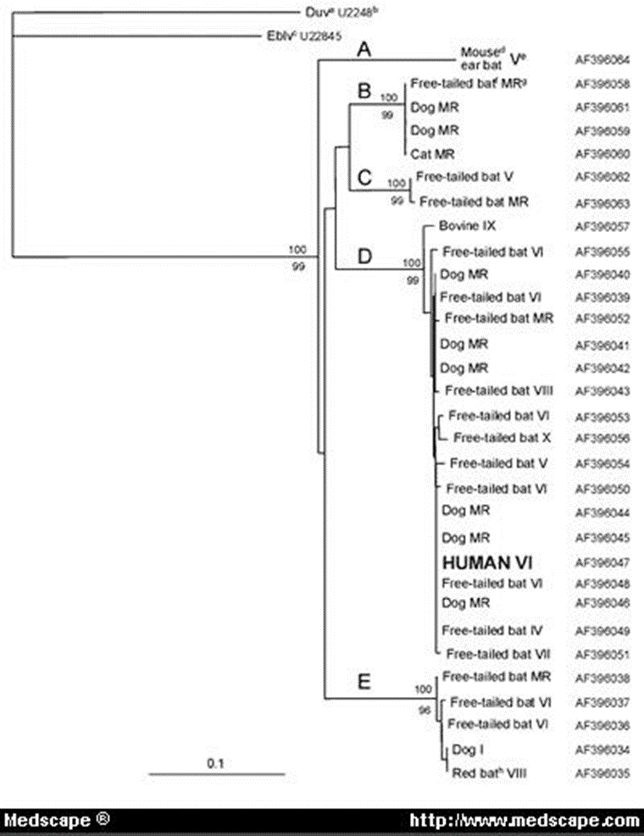
Molecular Epidemiologist
1353
1078
872
603
310
271,281
234
194
118
72
Raccoon (FL)
Blank
N.C. skunk
DDC (coyote)
Texas fox
Sonora dog
Arizona fox
Mw standard
Rohde R.E., S.U.Neill, K.A. Clark, and J.S. Smith. 1997. Molecular epidemiology of rabies epizootics in Texas. J Clin Virol. 8:209-217.

Slide 42
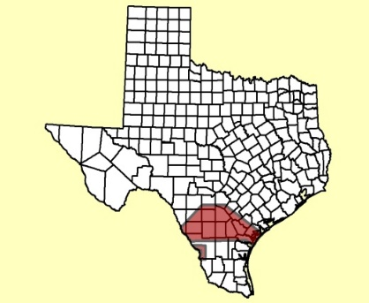
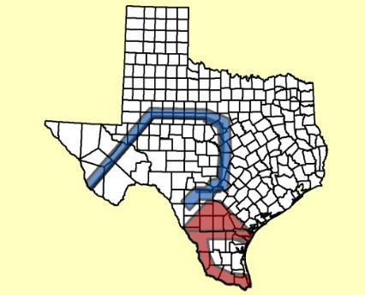
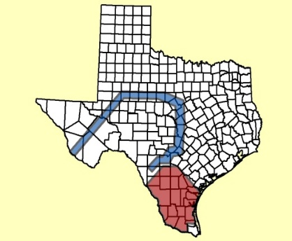
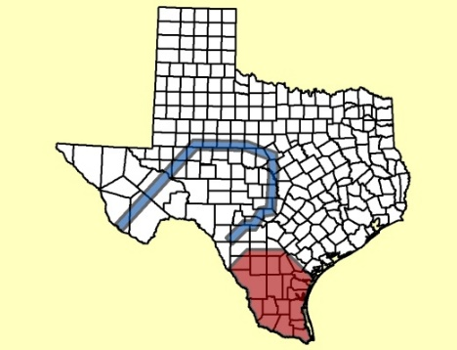
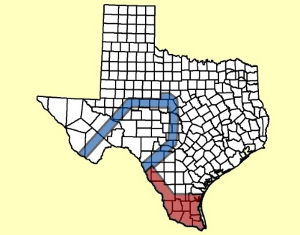
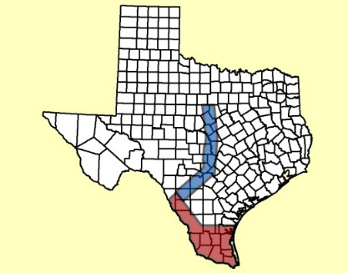
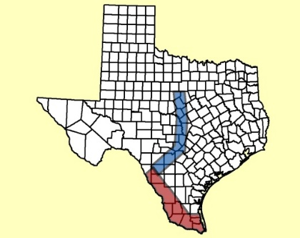
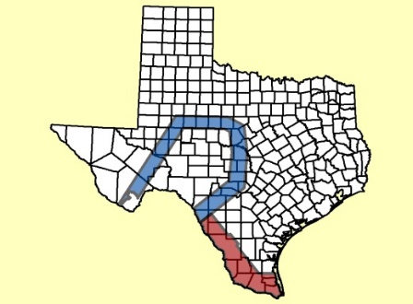
ORVP 1995-2002
Coyote
1995
1996
1997
1998
Gray Fox
1999
2000
2001
2002

Slide 43
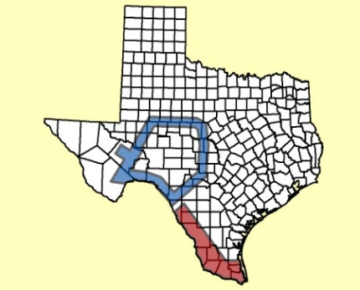
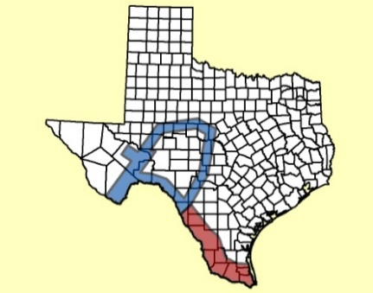
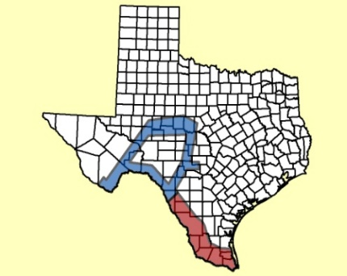
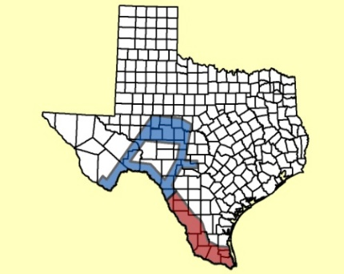
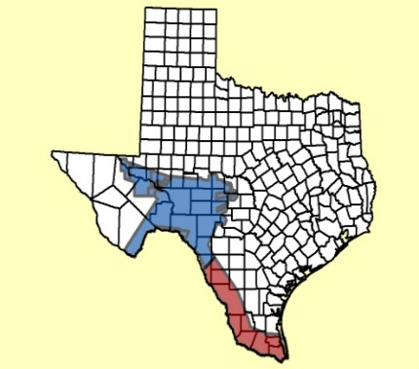
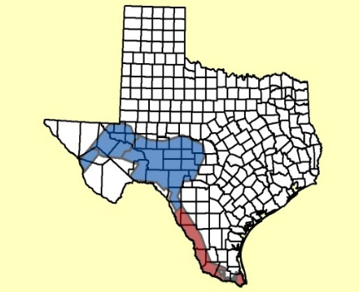
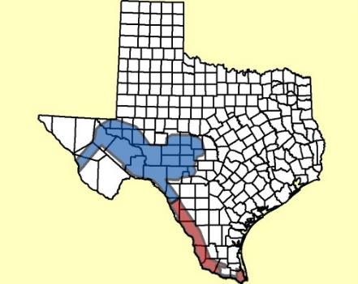

ORVP 2003-2010
Coyote
2003
2004
2005
2006
Gray Fox
2007
2008
2009
2010

Slide 44






Oral Rabies Vaccination Program 2011- 2016
2011
2012
2013
2014
2015

Slide 45

Oral Rabies Vaccination Program
2011-23 ongoing
2016 – 2024
Zones

Slide 46

Bait Distribution

Slide 47
Lessons Learned
Local is GLOBAL – We eliminated canine rabies in Texas!
#AnimalHealth + EnvironmentalHealth + #HumanHealth
  = #OneHealth
Implementation is a TEAM sport
Embrace technology, expertise, and opportunities
Science Communication & Translational Public Health are critical
The Medical Laboratory & Public Health are SYNERGISTIC

Slide 48


Future Concerns and the Texas ORVP
Continuing the border maintenance zone
  Mexico
  Arizona Fox variant
Raccoon Rabies
  mid-Atlantic foci
  translocation of raccoons for hunting
New Mexico
  Arizona Fox Variant
  Hot Spot Projects

Slide 49
References
Rohde R.E. & Rupprecht C. Rabies is an ancient, unpredictable and potentially fatal disease − two rabies researchers explain how to protect yourself. Rabies is an ancient, unpredictable and potentially fatal disease − two rabies researchers explain how to protect yourself (theconversation.com) The Conversation. January 9, 2024. https://theconversation.com/rabies-is-an-ancient-unpredictable-and-potentially-fatal-disease-two-rabies-researchers-explain-how-to-protect-yourself-219199
Rohde R.E. & Pamela J. Wilson. American Society of Microbiology, Bugs and Drugs article. The One Health of Rabies: It’s Not Just for Animals. September 28, 2021. https://asm.org/Articles/2021/September/The-One-Health-of-Rabies-It-s-Not-Just-for-Animals
Rohde RE and Rupprecht CE. Update on lyssaviruses and rabies: will past progress play as prologue in the near term towards future elimination? Faculty Reviews 2020 9:(9) https://doi.org/10.12703/b/9-9 Specific URL: https://facultyopinions.com/reports/b/9/9
Wilson, PJ, Rohde R.E. et al. 2019. Rabies: Clinical Considerations and Exposure Evaluations. Elsevier Press, St. Louis, Missouri 63043. (Invited book). ISBN: 978-0-323-63979-8 Ordering information: https://www.elsevier.com/books/rabies/wilson/978-0-323-63979-8
Rohde R.E. Rabies Disease, Transmission and Prevention: Just What Do You Know About Rabies? American Society for Microbiology, Invited online article, September 23, 2019. https://asm.org/Articles/2019/September/Rabies-Disease,-Transmission-and-Prevention-Just-W
Bonny Mayes, MA; Pamela J. Wilson, MEd; Ernest H. Oertli, DVM, PhD, DACVPM; Patrick R. Hunt, BS; Rodney E. Rohde, PhD, MS. Epidemiology of rabies in bats in Texas, 2001-2010. J Am Vet Med Assoc 2013;243:1129–1137.
Rohde, Rodney E. & Mayes, Bonny C., “Molecular Diagnosis and Epidemiology of Rabies.” In P. Hu, M. Hedge, & P.A. Lennon (eds.), Modern Clinical Molecular Techniques (New Edition), NY: Springer Press, 2012. [ISBN 978-1-4614-2169-6]: http://www.springer.com/medicine/pathology/book/978-1-4614-2169-6
Ernest H. Oertli, DVM, PhD, Diplomate ACVPM; Pamela J. Wilson, MEd; Patrick R. Hunt, BS; Thomas J. Sidwa, DVM; Rodney E. Rohde, MS, SV, SM, MP (ASCP). (2009). Rabies in Skunks in Texas. JAVMA, 234(5): 1-5.
Rohde, R.E. May, 2008. Controlling Rabies at its Source: The Texas Experience – Oral Rabies Vaccination Program. ASCLS Today, 22(5), 14-15.
Leslie, MJ, Messenger S, Rohde RE, Smith J, Cheshier R, Hanlon C, et al. Bat-associated rabies virus in skunks. Emerg Infect Dis [serial on the Internet]. 2006 Aug [date cited]. Available from http://www.cdc.gov/ncidod/EID/vol12no08/05-1526.htm
Sidwa, T., P. Wilson, G. Moore, E. Oertli, B. Hicks, R.E. Rohde and D. Johnston. Evaluation of Oral Rabies Vaccination Programs for control of rabies epizootics in coyotes and gray foxes: 1995-2003. J Am Vet Med Assoc 2005;227(5):785-792.
Rohde R.E., S.U.Neill, K.A. Clark, and J.S. Smith. 1997. Molecular epidemiology of rabies epizootics in Texas. J Clin Virol. 8:209-217.
Rohde RE, Mayes BC, Smith JS, Neill SU. Bat rabies, Texas, 1996–2000. Emerg Infect Dis [serial online]. 2004 May [date cited]. Available from: http://www.cdc.gov/ncidod/EID/vol10no5/03-0719.htm
Rohde R.E., P.J Wilson, B.C. Mayes, E. Oertli and J.S. Smith. January 2004. Rabies: Methods and Guidelines for Assessing a Clinical Rarity. American Society for Clinical Pathology, 2004 Microbiology No. MB-4 Tech Sample 21-29.

Slide 50





Thank you! Questions?

Slide 51

Q&A

Slide 52
Next Month’s Webinar:
March 27, 11 am – 12 pm CST
Supporting DEI Initiatives in the Laboratory Workforce

Slide 53
CMLE Credit Claiming for Today's Webinar
Claim 1 CMLE credit for this webinar from the ASCP Store
Instructions will be emailed to live attendees tomorrow 2/29 (via Zoom)
Credit claiming is only available within 1-month of the webinar date

Slide 54

Visit ASCP’s Support CDC OneLab™ Initiative Website!
Learn more about the CDC OneLab Initiative
Sign up for CDC’s free LMS, OneLab REACH™
Access ASCP’s free lab training resources, including:
  Negotiation & Advocacy Toolbox
  Case-Based Best Practices in Effective Test Utilization for Clinical Laboratories (eLearning)
Check-out open Volunteer Opportunities
Find out about Workforce Events & Scholarships
https://www.ascp.org/SupportCDCOneLab

