Slide 1
Laboratory AABB and CAP Reaccreditation Inspections
Presenter name and credentials, Title, Dept

Slide 2
Laboratory Inspection Summary
Moderate- and High-Complexity Laboratories in the United States are required by CMS/FDA (CLIA) to be inspected for reaccreditation every 2 years.
Accrediting agencies are granted “deemed status” to perform inspections and approve accreditation to the laboratory on behalf of the FDA (CLIA / the government).
CAP (College of American Pathologists)
AABB (Association for the Advancement of Blood & Biotherapies) –select portion of the CFR (CLIA)
Just like TJC, each of these entities have a percentage of their inspections audited – another team repeats an inspection to evaluate citations.
Inspection dates:
MONTH DD and DD – AABB and CAP – Transfusion Medicine
MONTH DD – CAP – All other sections

Slide 3
Comments from Inspectors / Commended Practices
“Really appreciate having the CAP checklists tied to procedures searchable in the document control system – easier for inspectors and for operations”
“Staff are very welcoming and know what they are doing.”
“The staff appreciation and staff board is a very nice touch that you do not see at many facilities and gives us a warm fuzzy feeling that is very welcoming for staff.”
“I want to clone the TM Specialist and take her back to my facility – she is so organized!”
“We would have no concerns being transfused at your facility”
“Your hospitality is fantastic, and I can tell that the lab is respected here.”
“Very well run, high-quality laboratory” (x2)

Slide 4
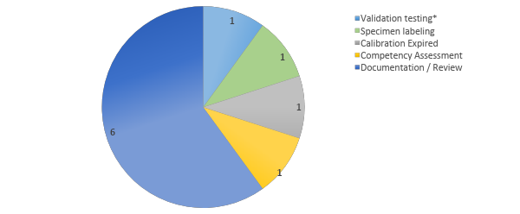
Citations by category
*Citation challenged and accepted .

Slide 5
Citation Details
Citation | Comment
Validation Testing - Body fluids and plasma – TIBC, URIC Acid, and Prealbumin - incomplete testing for modified FDA-Cleared testing | Interfering substances – Challenged – Removed
Specimen Labeling - Completed specimen label must be affixed to the sample container after collection and before leaving the presence of the patient. | TM specimen labeled prior to collection (RN)
Calibration Expired - Fibrinogen, HIT, d-dimer – Calibration not performed within 6 months | Performed at 7 months
Competency Assessment -TM not completed for East AND West | Same staff, same testing, duplicated
Documentation - E AVOX Monthly QC Review not completed between January – June 2022 | Reviewed in June, all acceptable
Documentation - AMR Verification review not signed off every 6 months | Signed off at 7 months
Documentation - Competency Assessment – missing for direct observation of maintenance and function checks | Removed from checklist in error
Documentation - Proficiency Testing – missing follow up and review of ungraded results. | Missed review
Documentation - BGLU - Accuchek QC expiration – not written on vial | ED and 5th floor
Documentation - PFA IQCP – not reviewed bienneially between 6/1/2020 and 3/16/2023. | No changes during timeframe.

Slide 6
Key Elements for Focus and Improvement
Modified competency assessment documents to meet requirements
Modified training to emphasize labeling of specimens and Accuchek supplies
Developed systems to ensure tasks are completed at set intervals (Calibration, AMR verification, and IQCP reviews)

