Slide 1
Service Excellence
Creating a positive experience for our patients and customers

Slide 2
Today’s Objectives
Our overall objective is to help each other learn how we can improve the way we relate to patients, internal and external customers.
Improve the image that our patients have of us as competent professionals
Reduce the amount of stress that we all experience in our work
Develop skills that can be great benefit to us in our daily lives.

Slide 3
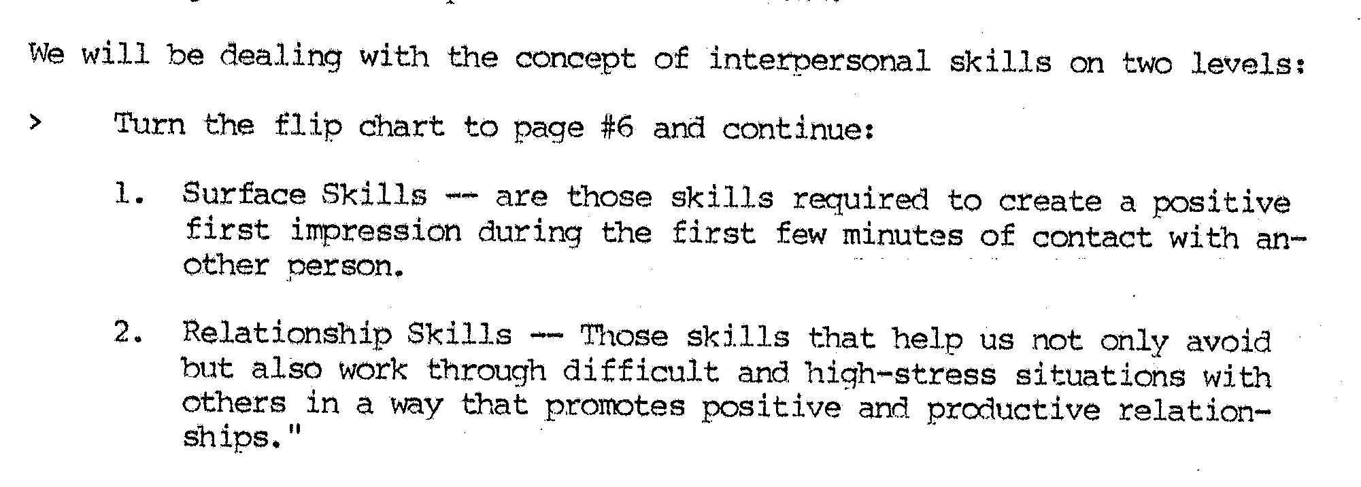
Exercise 1
I return to a place of business when…
I would not return to a place of business when…

Slide 4
First Impressions
Please read the card and tell me how many “F’s” there are in the sentence.
You have 20 seconds.
How many “F’s” did you count?

Slide 5
Finished files are the result of years of scientific study combined with the experience of years... There are 6 ‘F’s on the card!

Slide 6
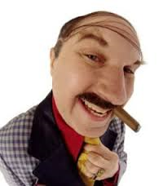
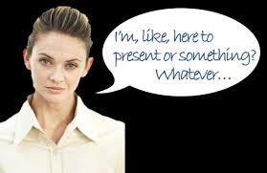
never get a second chance to make a first impression!

Slide 7
First Impression
You never get a second chance to make a first impression.

Slide 8
Surface Skills
Skills required to create an immediate, positive and caring impression in the minds of our patients and visitors.
The first impression is formed visually, before the contact begins and in the first few moments of verbal exchange.
Imagine for a moment you are a patient or visitor entering the hospital. What would you need to see and how would you have to be treated in order to feel that this is a GREAT hospital?

Slide 9
C.A.R.E.
There are many effective ways for you to present a highly professional & caring image to patients, visitors and co-workers. If you consciously apply them we all reap the benefits.
How would you show:
COURTESY
ATTITUDE
RESPECT
ENTHUSIASM

Slide 10
CARE diagram
COURTESY
Simple acts of courtesy take little or no extra time. They help others feel more at ease and pave the way for harmonious relationships.
ATTITUDE
A positive attitude has a powerful influence on the way others fell and relate to you.
RESPECT
As professionals we have great respect for each other, the work we do and for the needs and feelings of patients and coworkers.
ENTHUSIASM
Enthusiasm truly is contagious. It helps others feel more confident in you and your ability
C
A
R
E

Slide 11
Relationship Skills
Listen
Customer Service
Take Action
Empathize
Fact Finding

Slide 12
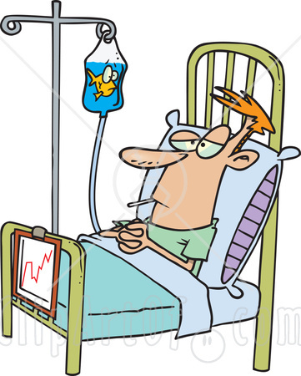
The Case of Mr. Smith

Slide 13
Correct answers
Friday
March
9:35 PM
Bill
Helen
John
Mr. Roberts
45 minutes
Dr. White
The correct answer for the questions 10 through 20 are “Don’t Know.”
Score your tests by counting all of the correct answers and multiply by 5.

Slide 14
Listening and Empathizing
Listening and empathizing when done properly, are the most effective skills for reducing interpersonal stress.

Slide 15
Good Listening Skills
First consider your surrounding and the nature of the discussion.
You may need to move to quieter surroundings and a private area.
Stand in a relaxed but alert position
Tends to lean slightly forward
Faces you with whole body
Makes eye contact
Asks questions for clarification
Does not fidget or play with objects
Give full attention to the speaker
Gives signs they are listening… “I see”, “please go on” head nodding or summarizes main points for clarification.
Gets on the speakers physical level
Provides feedback to check for understanding

Slide 16
Listening for feeling
Listen to how the words are said:
Be aware of changes in the speaker’s voice:
Anger
Fear
Sincerity
Warmth
Excitement
Pitch
Volume
Speed

Slide 17
Empathy
The ability to sense other people’s emotions, coupled with the ability to imagine what someone else might be thinking or feeling.
Empathizing is letting others know you understand and are sensitive to their feelings without indicating your personal agreement or disagreement with what is being said.
It helps others understand you are really interested in their problems and are sensitive to their feelings.

Slide 18
Empathy
Focus your attention outwards.
Be mindful and aware of your surroundings, especially the behaviors and expressions of others.
Research suggests that practicing mindfulness helps us take the perspective of other people yet not feel overwhelmed when we encounter their negative emotions.

Slide 19
Phrases you can use…
I can imagine how upset you are.
I can see that you are upset.
I’d feel the same way if I thought…
I know it can be frustrating.
I think I’ve felt the same way myself.
I’m sorry you are upset.

Slide 20
Fact Finding
Ask permission to ask questions
Ask the questions
Feed-back for understanding
Present the situation as you understand it.

Slide 21
Taking Action
When developing solutions it’s important to get the other person involved as much as possible in deciding how to solve the problem.
Once the mutually agreeable solution developed, the final step is to gain commitment for action:
What will be done
Who will do it
When it will be done
What arrangements if any are needed for follow-up
End by saying “I’m glad that I was able to assist you.” Or, “Is there anything else I can help you with?”
Remember that little things mean a lot to your patientsand other customers.

Slide 22
Let’s review what we have learned…
First impressions
Surface skills
C.A.R.E.
Relationship skills
Good listening skills
Empathizing
Fact finding
Taking action

